Slide 1
2 hours @Paris an exemple for Afterwork
IBM Capstone project

Slide 2
Introduction
Paris is the most visited city over the world by the international traveler, but in fact, the name of Paris means two different geographic definitions for the local people:
For the Paris city heart : the real city heart 105KM² with 20 districts (in French, arrondissement)
For the Big Paris city: the 20 districts and the department 92/93/94 (in French, Paris petite couronne)
The most of CBDs around Paris city heart are located in the 92/93/94 department. For the people who work around Paris, even the urban is well developed, the city heart remain always the most popular place for their afterwork/team building: because of the historical place, more choice for café, bar and restaurant, much more approach to the theater, cinema, park and the Seine river…

Slide 3
Problem
The 92/93/94 departments make a circle around Paris, thus the data can help the people who works there to know where to go for the after work/team building, according the city heart district that they choose
The project aims to locate, a good place for the after work place by district, in order to meet business request.

Slide 4
Data Source
The Wikipedia source:
https://en.wikipedia.org/wiki/Arrondissements_of_Paris#Arrondissements
The Paris city open data :
https://opendata.paris.fr/page/home/
This is a very interesting and powerful open source data base for Paris city. Many developer works on it and the user can get the all needed format data on it, as for this project, I use the city’s GEOJSON.
The foursquare :
The foursquare API can be used for the venue data. The site is one of the largest database for more than 100Millions places worldwide and it is used by over 130 000 developers. In this project, the Paris city venue data will be explored based on the interest place by district.

Slide 5
Data cleaning and processing (1/2)
From the Wikipedia site, the objective of this project is that take the maximum data possible from there, at least: Name of district, the area, position compared to the Seine river (left or right), name of interest place that can be visited (at least one by district)
From Paris open data website, the key is to use the arrondissement GEOJSON, means that the objectif, is to get the outcome in a Paris map with the location of interest place.
The data from Foursquare is the last data set to be merged with the cleaned data. The objective is to show among the 20 district, which is the most popular one and within the scope, and then get the venue data.

Slide 6
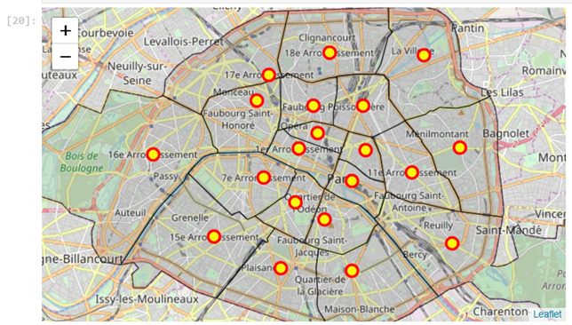
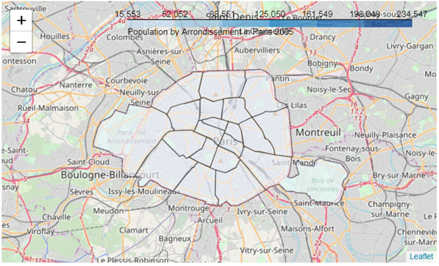
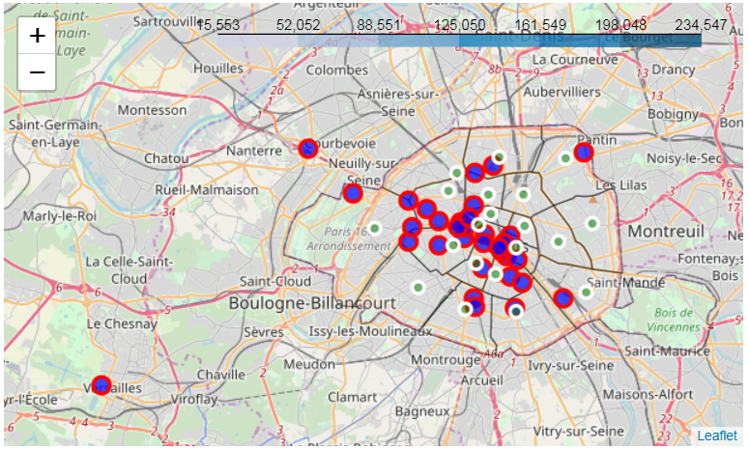
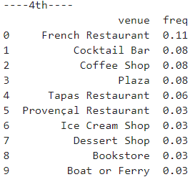
Data cleaning and processing (2/2)

Slide 7
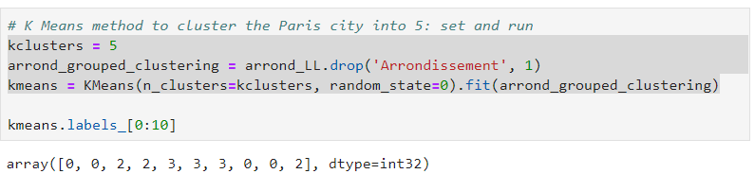
Data clustering and discussion (1/2)
this step goes straight for the aim of this project: give out the suggestion by clustering the venue by district. The test is done with the K means methodology.

Slide 8
Data clustering and discussion (2/2)
if the 2 hours choice is made among the 1st to 8 arrondissement, the difference is slight, in another word, from 1 to 8 arrondissement, we can pick ant district and every choice must have at least one top noted interest place with the bar or café or restaurant nearby.
From 9 to 20 arrondissement, the choice could be limited:
for the 12th, the best place should be around the bois de Vincennes,
for the 13th, the choice could be made for the Asia food and his culture,
for 16th or 17th, the 2 hours place could be the axe of Champs Elysee or the Bois de Boulogne,
for the 18th, the choice should be done around the Sacré Coeur and Montmartre

Slide 9
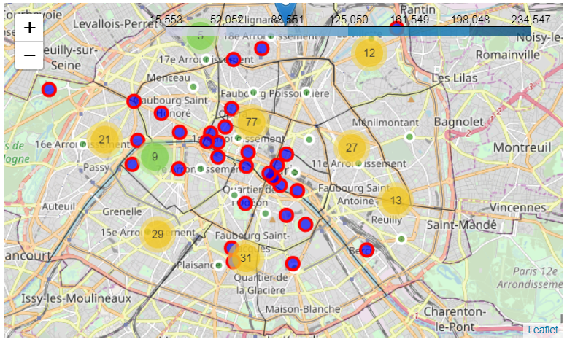
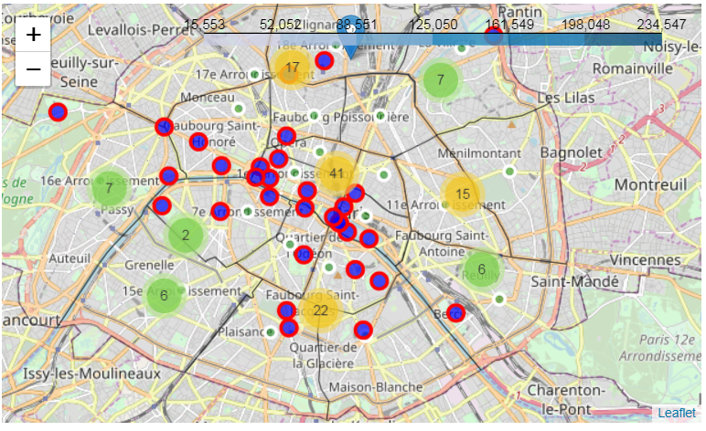
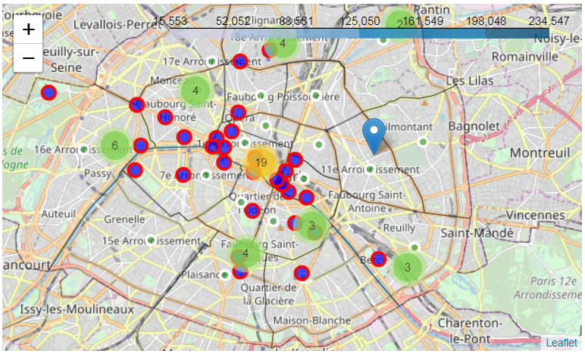
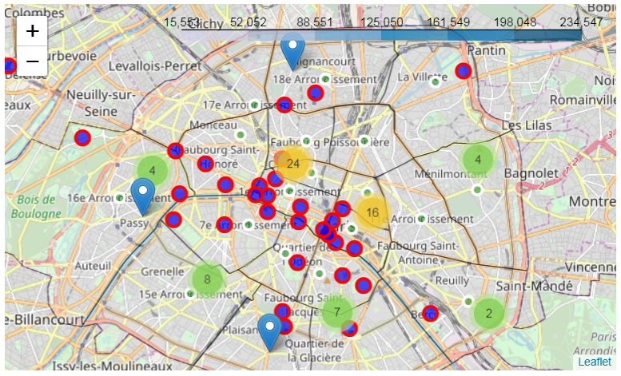
French Restaurant
International Restaurant
Museum
Dessert

Slide 10
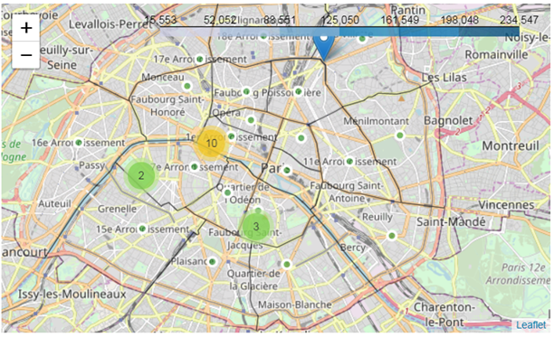
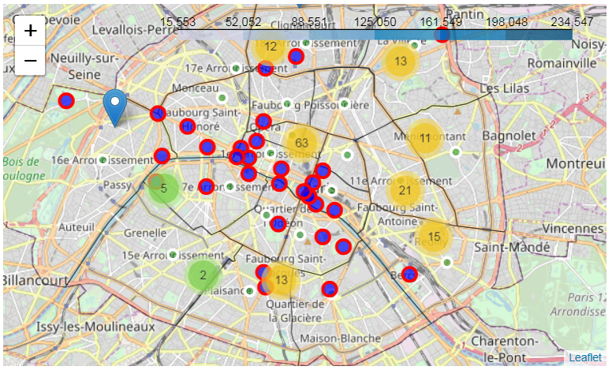
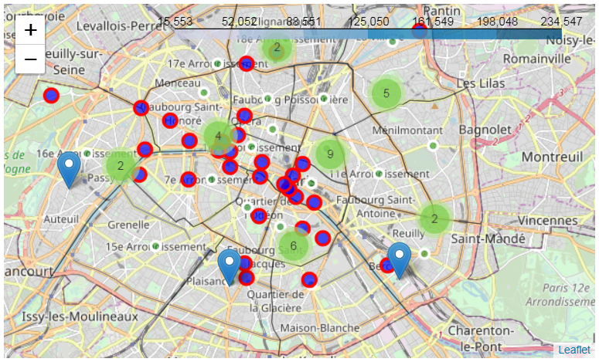
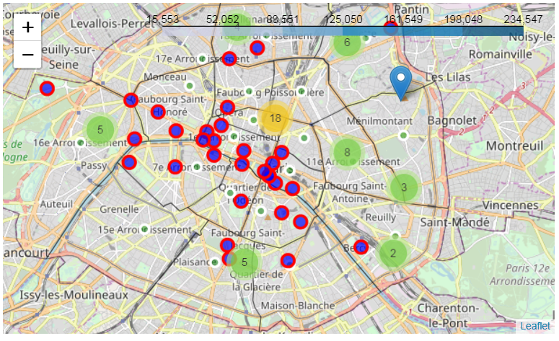
Historical site
Drink
Coffee
Fast food

Slide 11
Conclusion
Paris city heart is a small area and it is very easy to make a choice for 2 hours after work. The topic of the after work could be very varied, from interest place to shopping, from French food to drink. The best choice is in the 1-8 arrondissement, that means during 2 hours, the after work can be organized in 2 activities as the places are concentrated.

